Slide 1
Chapter 25
Network Software tools and Commands

Slide 2
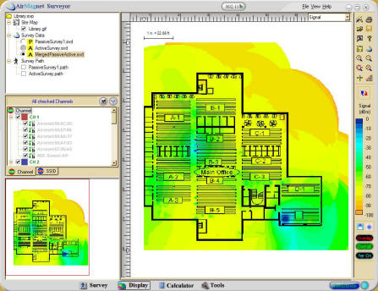
Wifi Analyzer
Notes:
You can see Wi-Fi coverage in an area and use that information for optimal access-point placement to get complete coverage and avoid dead spots

Slide 3
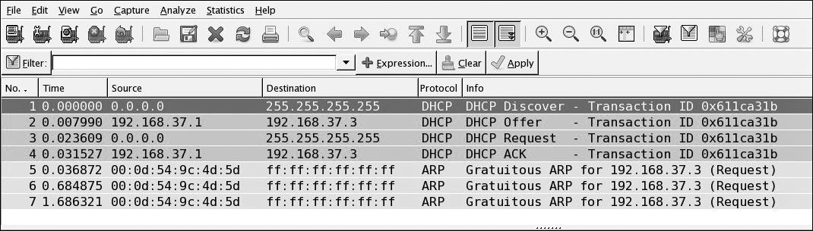
Protocol Analyzers
Used to capture packets in their raw format as they cross the network
Analyze DHCP Packets
Discover
Offer
Request
Acknowledgement
Notes:
Wireshark

Slide 4
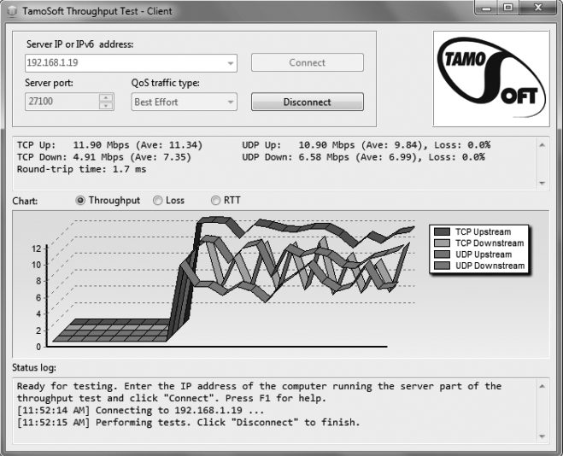
Throughput Testers
Work much like a protocol analyzer in that they measure the traffic seen on the network and can also classify the types of traffic that are eating up bandwidth
Notes:
Speedtest.net

Slide 5
Network Scanners
Port Scanners
A port scanner is a software tool designed to search a host for open ports.
A portscan is the act of scanning for Transport Control Protocol (TCP) and UDP open ports on a single target host.
Port sweeping means scanning multiple hosts on a network for a specific listening TCP or UDP port.
Notes:
Bad guys use port scanners to use them to find a network’s vulnerabilities and compromise them
Port sweeping is looking for vulnerabilities on multiple hosts

Slide 6
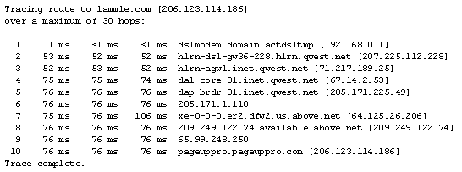
Command-Line Tools
traceroute / tracert
Traceroute (trace for short) displays the path a packet takes to get to a remote device by using
Time-To-Live (TTL)
Time-outs
Internet Control Message Protocol (ICMP) error messages

Slide 7
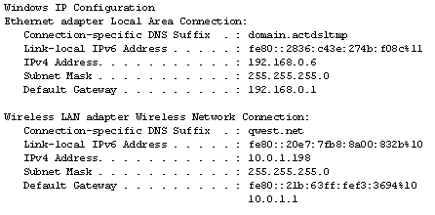
Command-Line Tools
ipconfig and ifconfig
The utilities known as ipconfig (in Windows), and ifconfig (in Unix/Linux/Mac) will display the current configuration of TCP/IP on a given workstation.
Current IP address
DNS configuration
Windows Internet Naming Service (WINS) configuration
Default gateway
7

Slide 8
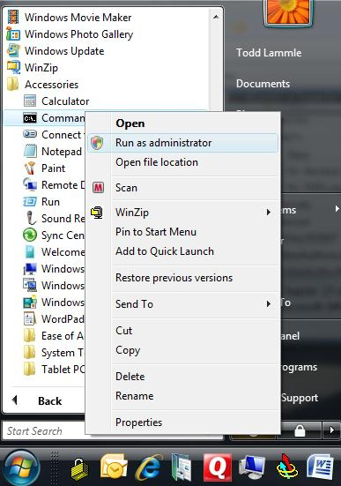
Command-Line Tools
IPConfig Options
Ipconfig /all
Ipconfig /release
Ipconfig /renew
To release your current DHCP TCP/IP information in Vista, you must elevate your command prompt.
8

Slide 9
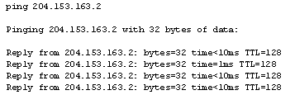
Command-Line Tools
The ping Utility
Ping is the most basic TCP/IP utility, and it’s included with most TCP/IP stacks for most platforms.
In most cases, ping is a command-line utility, although there are many GUI implementations available.
You use the ping utility for two primary purposes:
To find out if a host is responding
To find out if you can reach a host

Slide 10
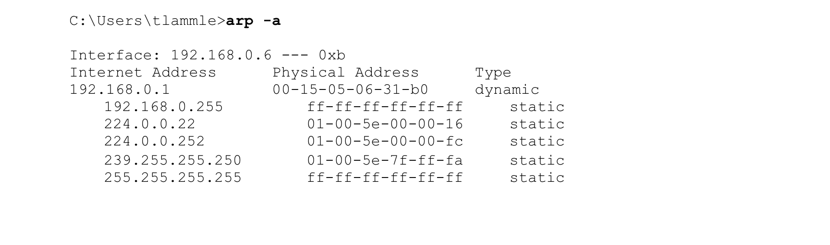
Command-Line Tools
Address Resolution Protocol (ARP)
The Address Resolution Protocol (ARP) is part of the TCP/IP protocol stack.
Uses broadcasts to translate TCP/IP addresses to MAC addresses.
The ARP table in Windows includes a list of TCP/IP addresses and their associated physical (MAC) addresses.
The ARP table contains two kinds of entries:
Dynamic
Static
The arp Utility (using “arp –a”)
Notes:
Arp –a: Displays current ARP entries by interrogating the current protocol data

Slide 11

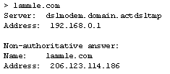
Command-Line Tools
The nslookup Utility
A command-line utility that allows you to perform a single DNS lookup for a specific entity.
The nslookup utility comes with Windows NT and later, as well as most versions of Unix and Linux, but not with Windows 95/98.
It is run from a Windows command prompt.
At the command prompt, you can start the nslookup utility by typing nslookup and pressing <enter>.
11

Slide 12

Command-Line Tools
The netstat Utility
netstat is a great way to check out the inbound and outbound TCP/IP connections on your machine.
Packet statistics like how many packets have been sent and received, the number of errors, etc. can be viewed.
Notes:
Displays all TCP connections

Slide 13
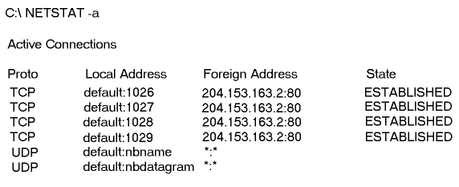
NetStat
The netstat –a command:
Notes:
Displays all active connections including UDP

Slide 14
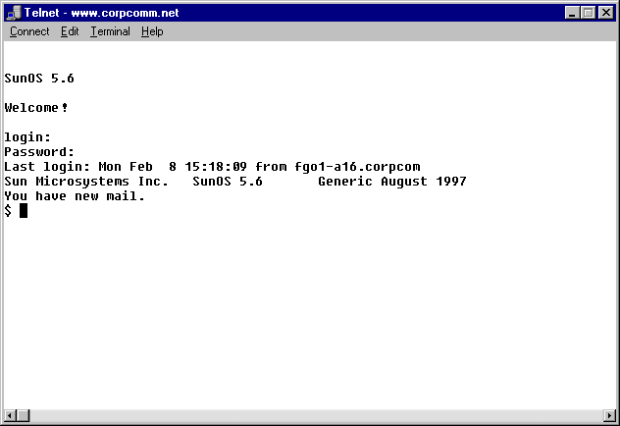
Command-Line Tools
The Telnet Utility
Part of the TCP/IP protocol suite
Telnet is a Terminal Emulation program designed to be used over the network.
Telnet allows you to make connections to remote devices, gather information, and run programs.
Telnet was originally developed to open terminal sessions from Unix workstations to Unix servers.

Slide 15
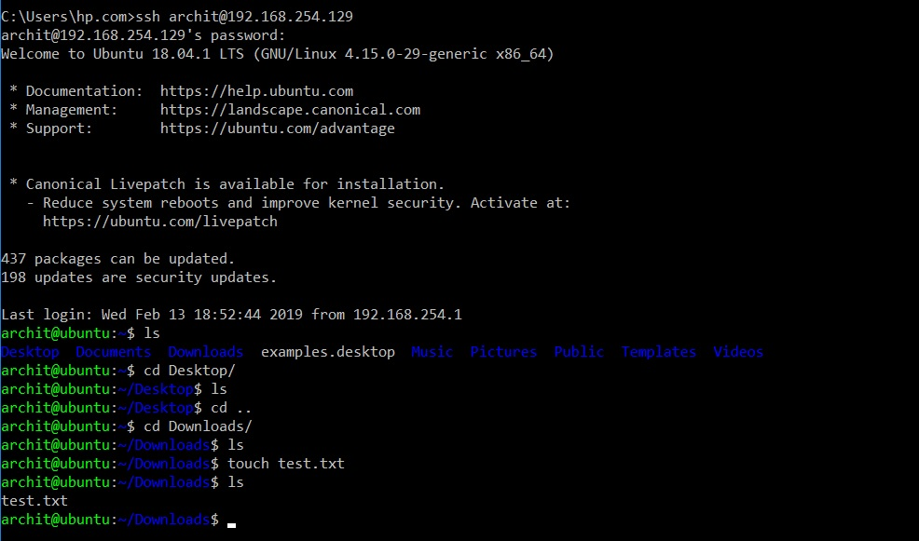
Command-Line Tools
Don’t Use Telnet, Use Secure Shell (SSH).
Telnet is totally unsecure.
Telnet sends all data in clear text including your name and password.
It has to be a really bad thing these days; consider Microsoft doesn’t even enable it on their latest Oss (you know it really must be unsecure).
SSH is the tool to use.
SSH provides the same options as Telnet, plus a lot more.
It doesn’t send any data in clear text.
Your servers, routers, and other devices need to be enabled with SSH.
SSH is not configured by default on most devices.

Slide 16
Basic Commands
Show interface
Show Config
Show route
Notes:
Show interface: displays stats for network interfaces
Show config: shows the current router, switch, and firewall configuration
Show route: displays the IP routing table

